Slide 1


ScARF: Scottish archaeology as a regional jigsaw – creating localised frameworks.
Emma Jane O’Riordan
ScARF Project Manager

Slide 2
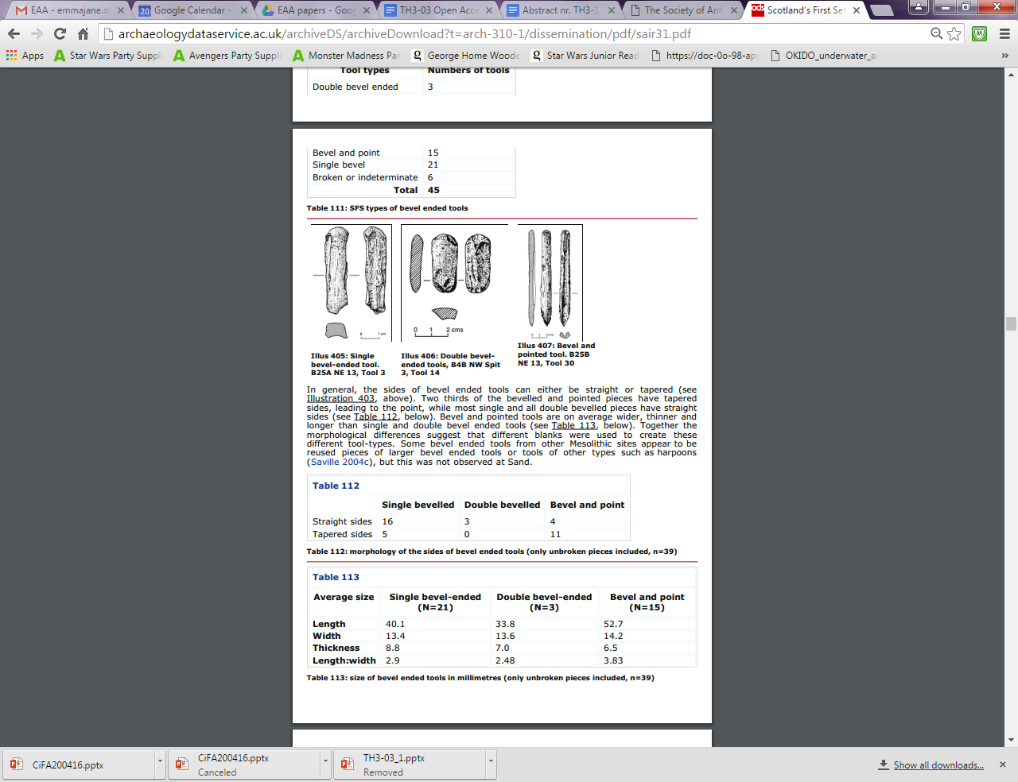
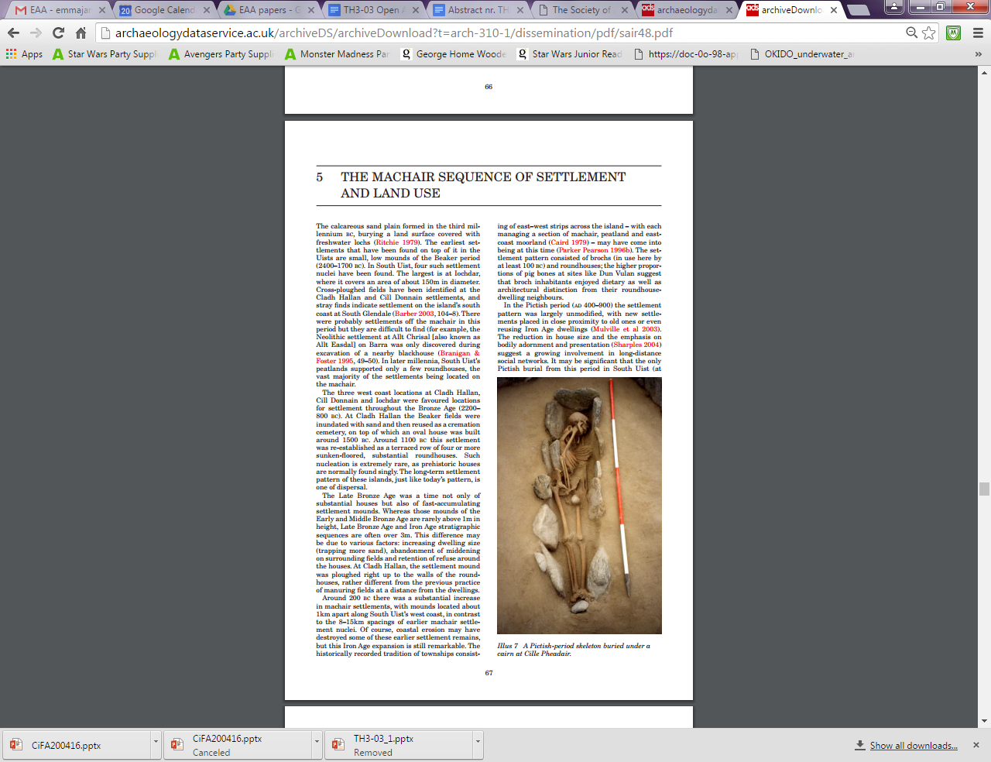
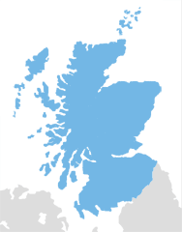
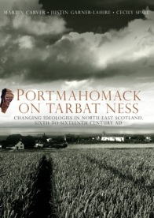
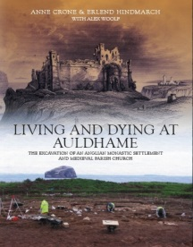
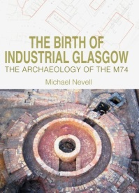
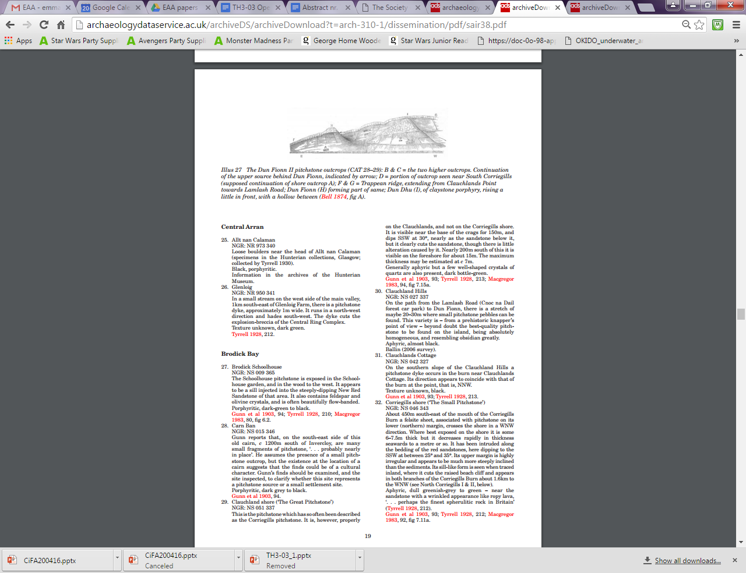
The Society has been publishing since 1792…
Large scale excavation surveys
Books
Conference proceedings
as well as the Proceedings and SAIR!
Gazetteers
Notes:
We have been publishing material on archaeological and historical topics since 1792 and have produced the journal Proceedings of the Society of Antiquaries of Scotland (PSAS) annually since 1851. I say annual, and I mean annual. Not even events such as World War could halt publication of the Proceedings. This unbroken record of publication means that the Society has an unparalleled Scottish record of research excavations, rescue excavations, archaeological surveys, studies of objects, overviews of historical records, publication reviews and more.
I mentioned large-scale surveys, gazetteers and conference proceedings – which would not be possible or desirable to publish in print for various reasons
Today, we are a society that is actively supporting the study and enjoyment of Scotland’s cultural past. We do this in part through publishing high-quality, richly illustrated books (currently 28 in print and we publish 4-6 books per year) covering all aspects of Scottish history and archaeology, as well as our yearly journal, the Proceedings of the Society of Antiquaries of Scotland, and our online journal, Scottish Archaeological Internet Reports (SAIR). The Society maintains a firm commitment to our remit as an educational charity by making as many of our publications free and open access to the public as we can.

Slide 3

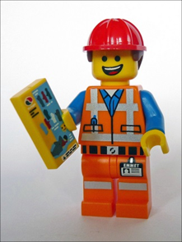
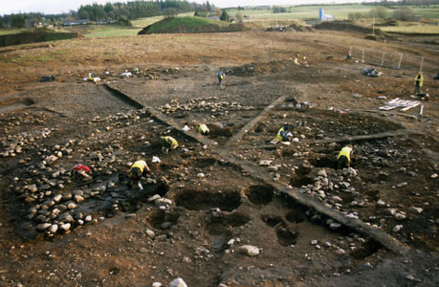
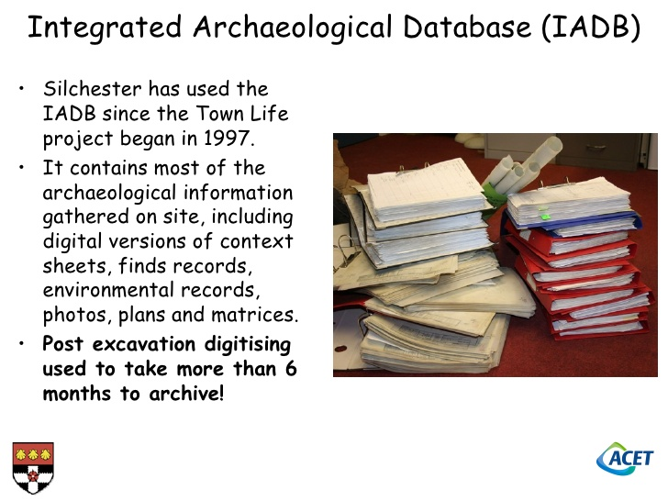
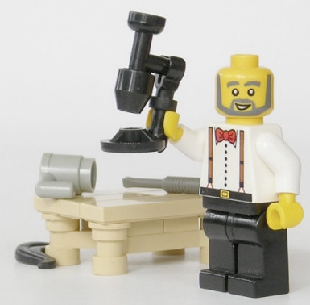



has been around since 2012
Content is
Peer reviewed
Authored by top minds in the field
Summaries and current research capacity
The resource is
Online
easily discoverable
Easily updateable
free for all
Notes:
The lego people are all the types of person that we might involve

Slide 4
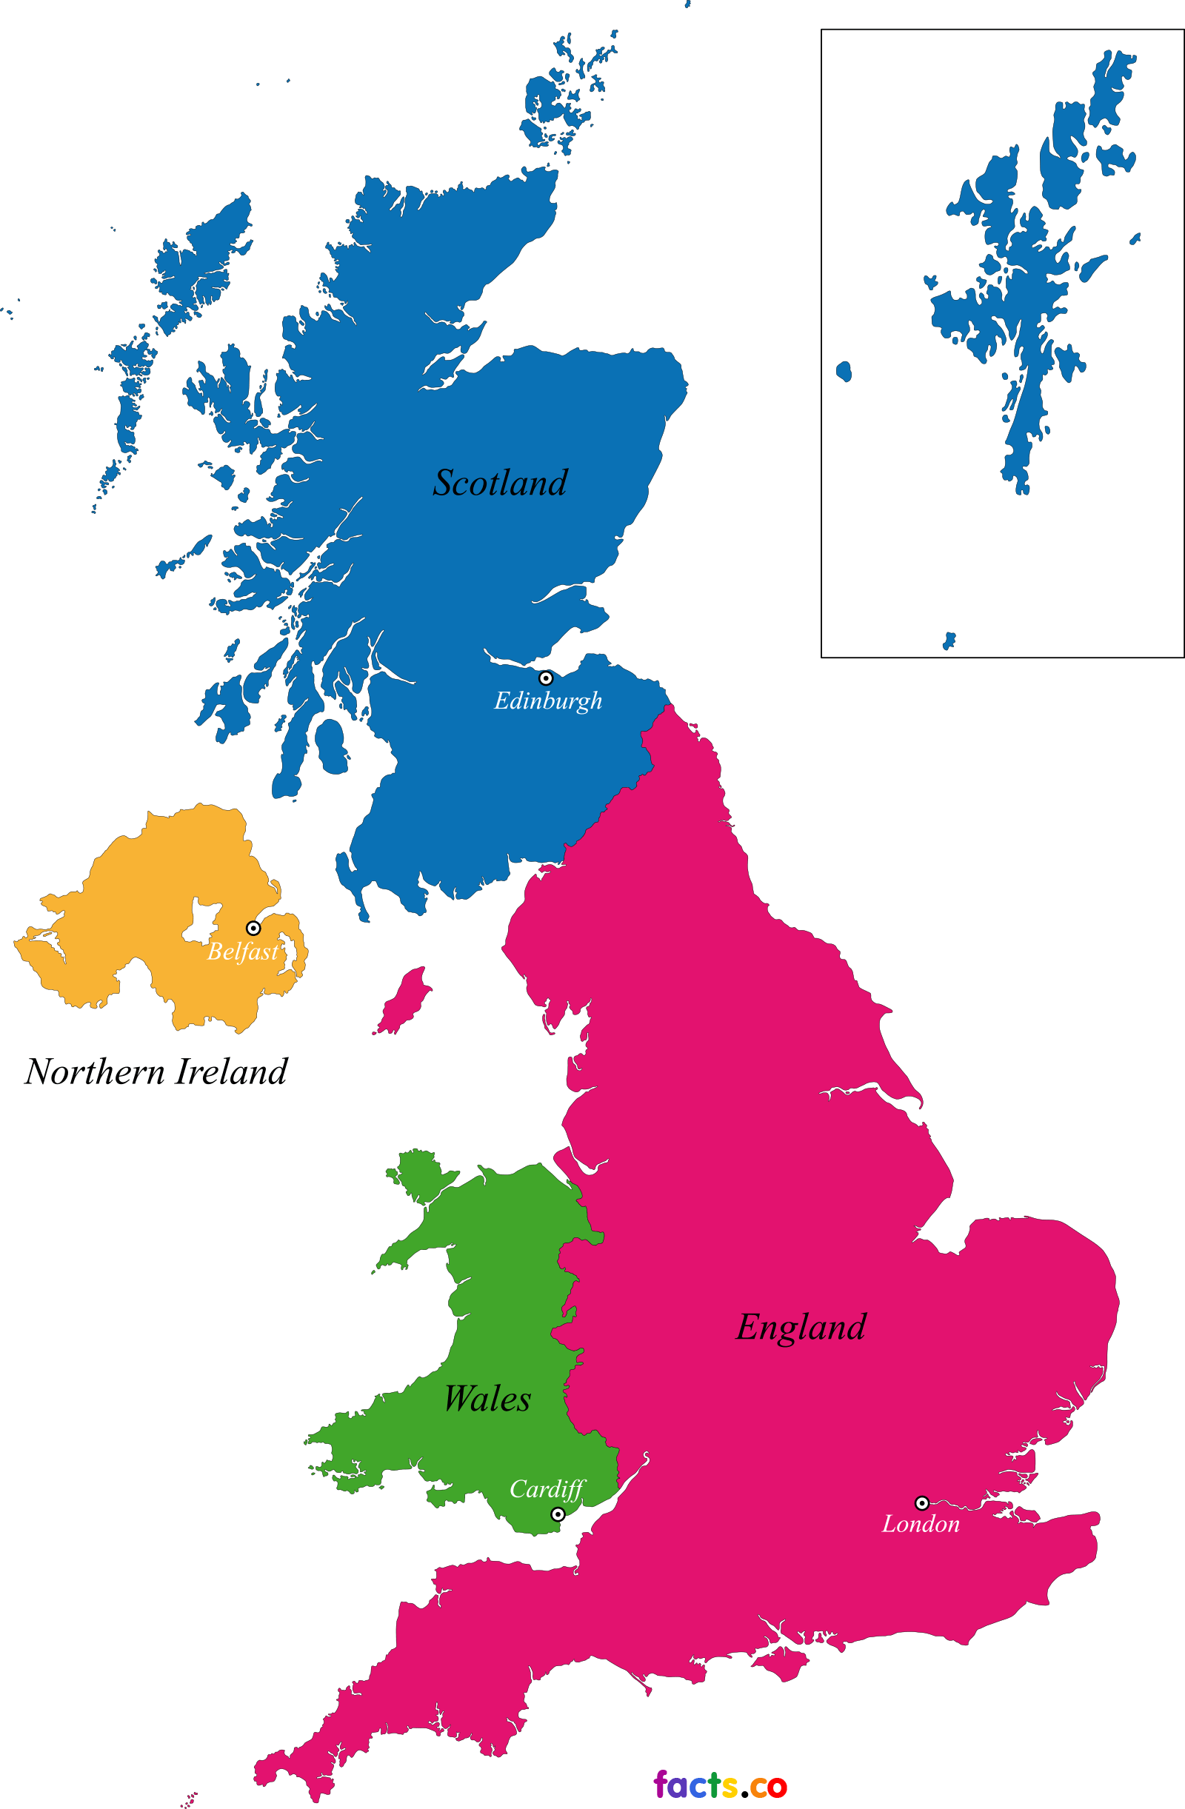
The current situation?
1 National framework
2 regional frameworks in development
World heritage sites
No overarching framework
No national framework
Around 57 regional frameworks
World heritage sites
National parks
No National framework
5 regional frameworks
Updates will be by theme

Slide 5
Levels of research questions
Dissertations
Phd Thesis
Collaborative Studies
The role of decoration and colour in Iron Age societies remains to be investigated.
Can any trends over time be identified in either the shape and layout or construction of dwelling structures?
Investigate the material and technological aspects of Scottish industries, such as glass, paints/varnishes and other materials used in building and decorating, on a diachronic basis from their earliest manifestations to the early twentieth century.
A major study linking new work in palaeoclimatology and archaeology is of immediate importance and Scotland currently provides one of the strongest data sets for such work.

Slide 6
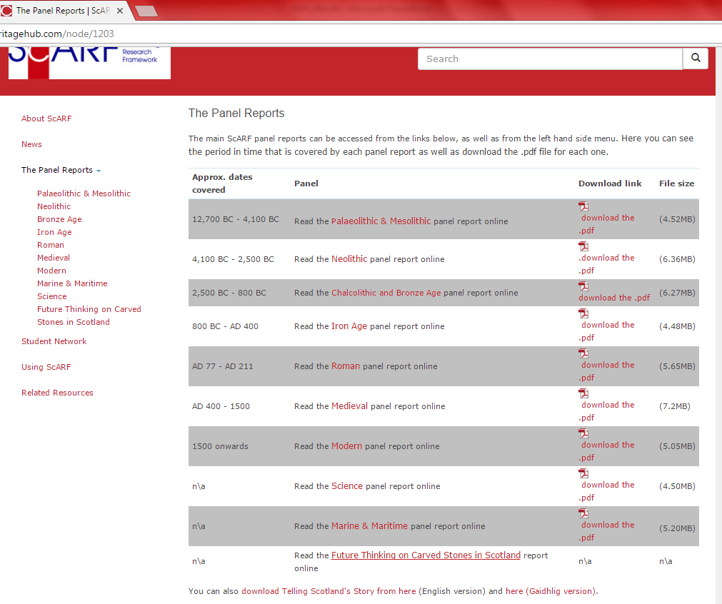
Where does archaeology happen?
?
Notes:
Up until now, ScARF has been national.

Slide 7
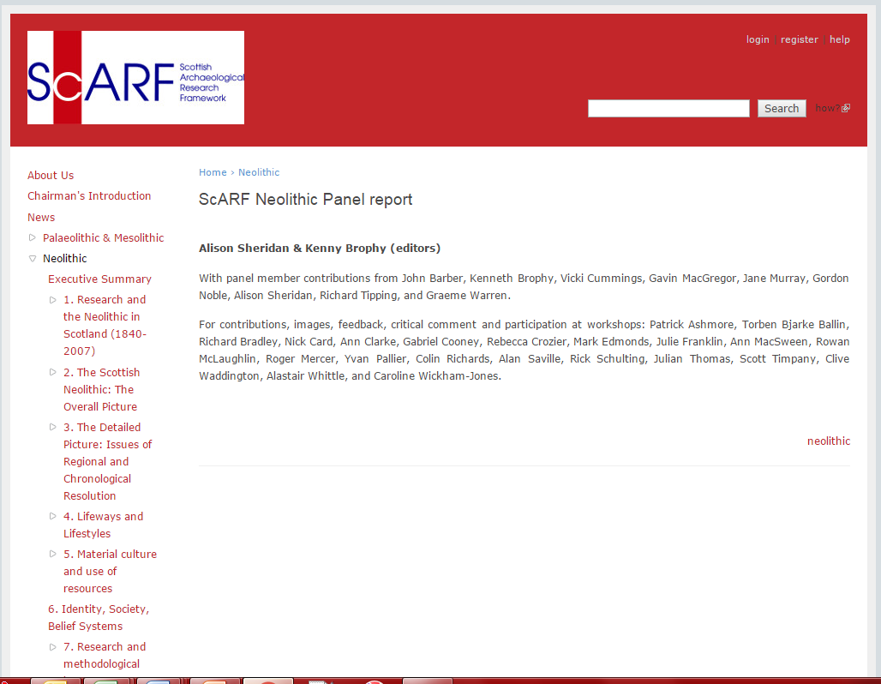
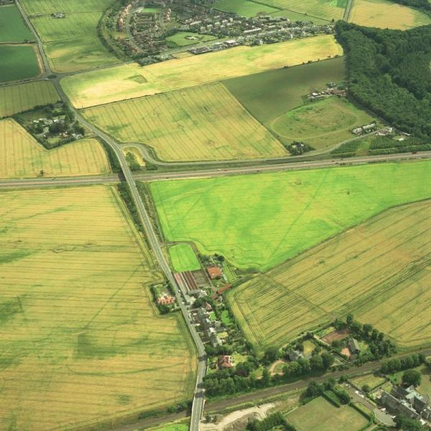
Regional Archaeological Frameworks
The Neolithic is the only current panel report with
clearly defined regional summaries
clearly defined research objectives
for each region.

Slide 8
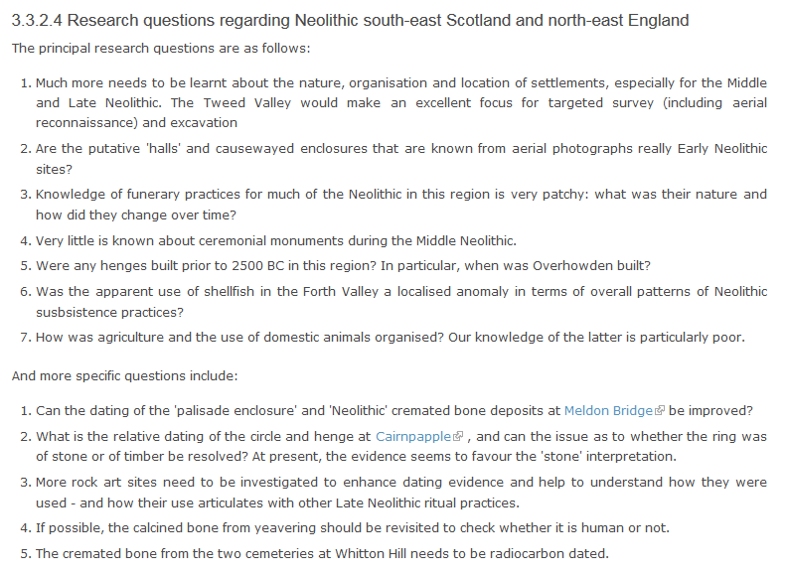
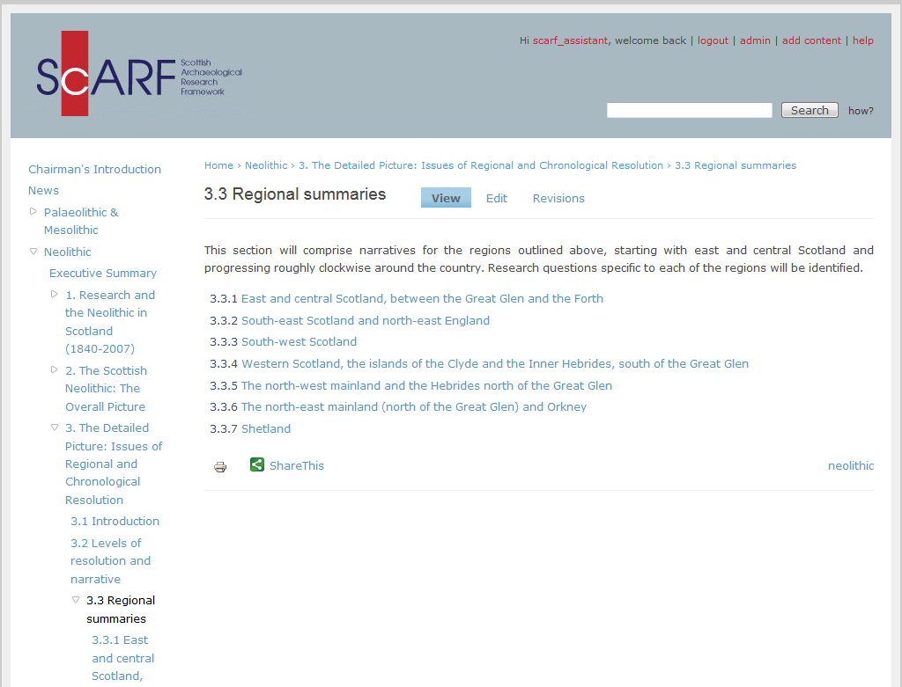
Regional research questions

Slide 9
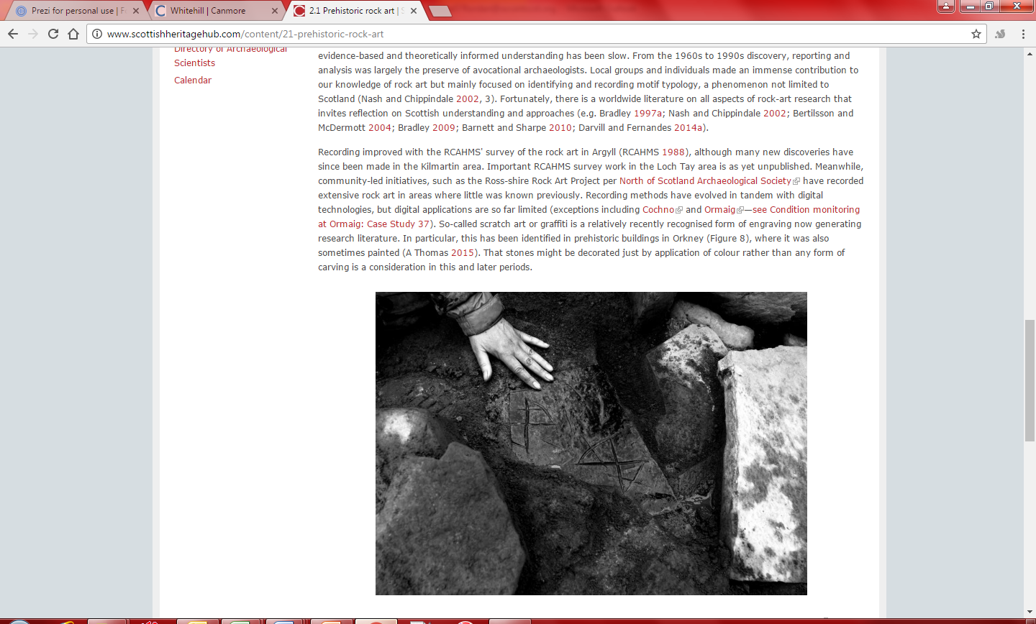
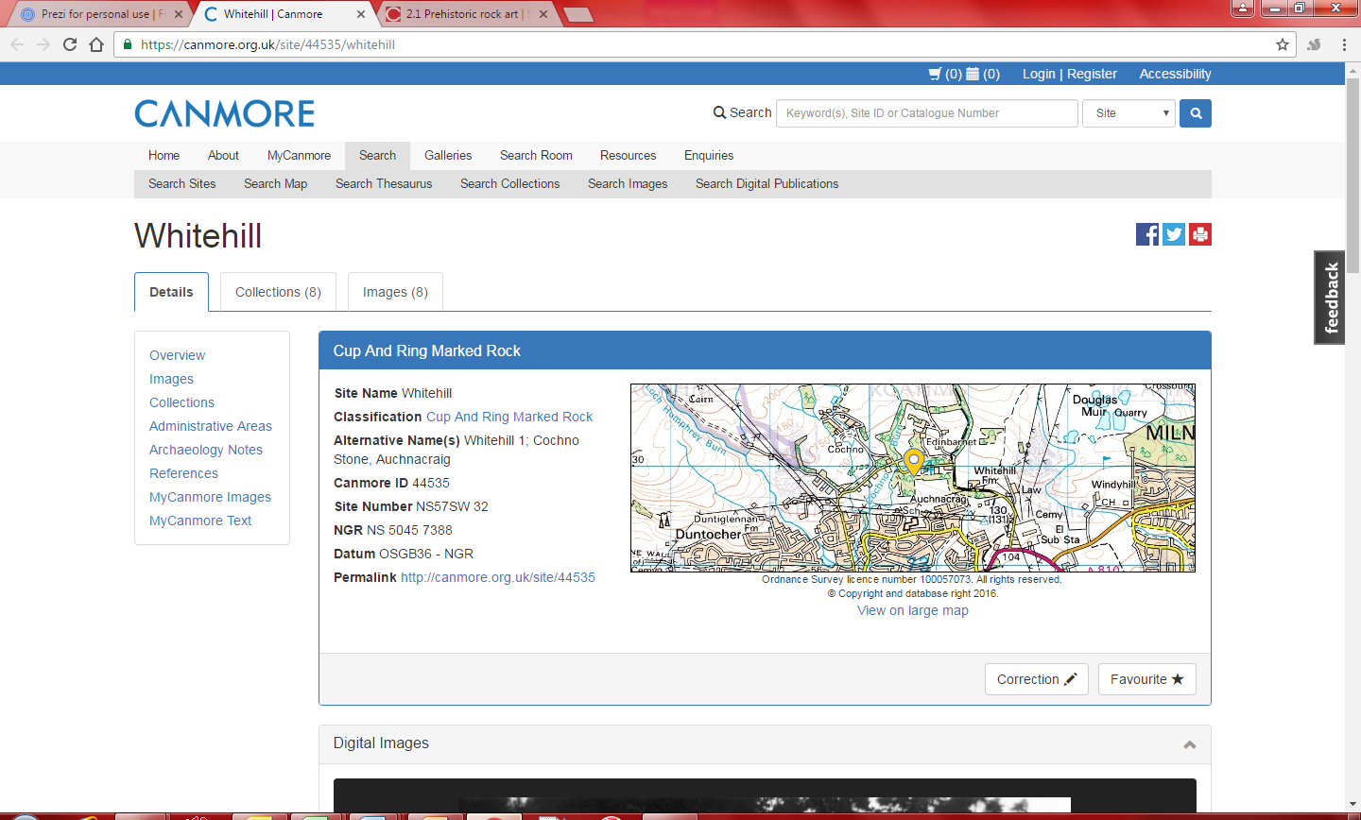
Places in ScARF
CANMORE links

Slide 10







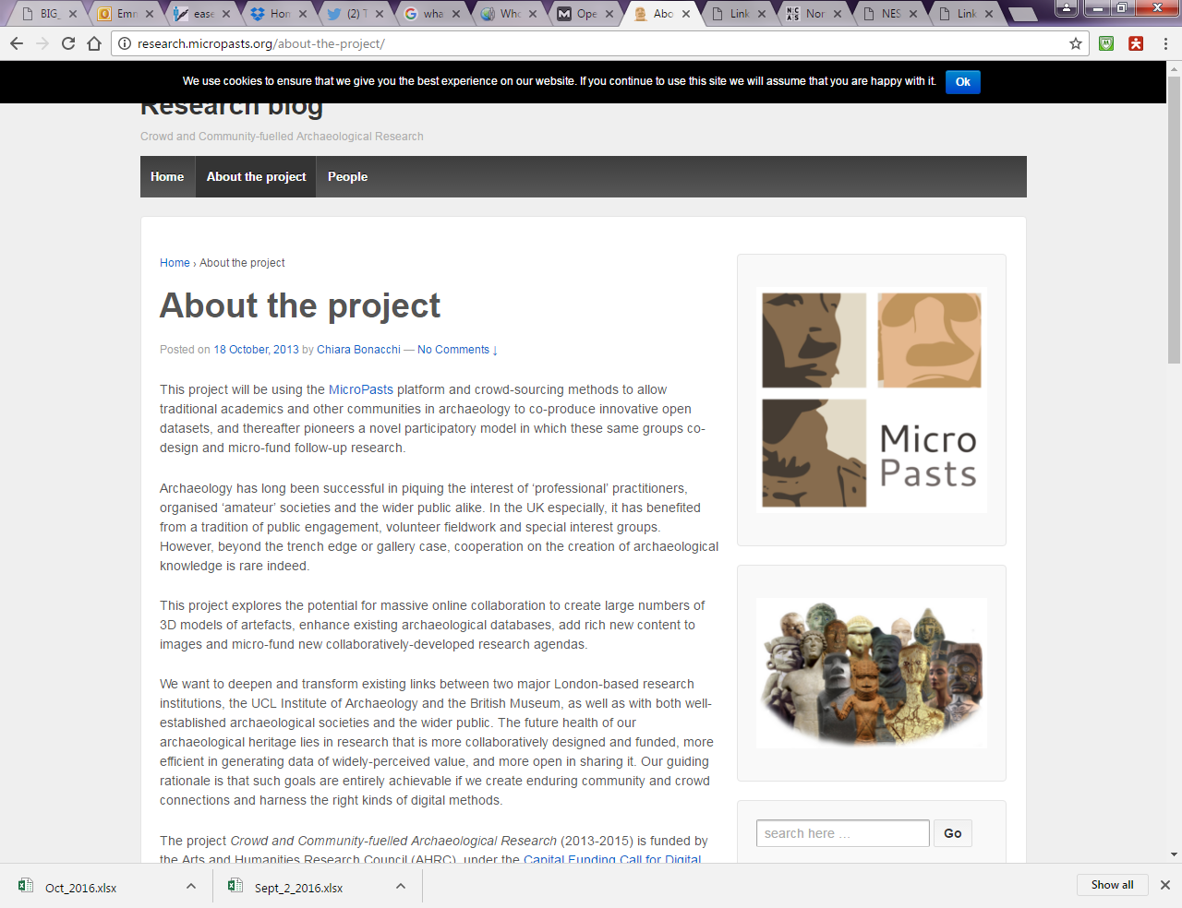



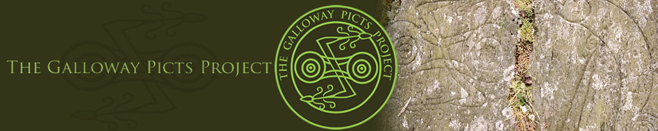

Who cares about places anyway?
Commercial
Site Evaluation
Watching Briefs
Desk Based Assessments
Academic
Others
National Trust
Forestry Commission
Historic Environment Scotland
Lecturers
Students
Researchers
Community groups
Environmental Impact Assessments
Post Excavation Research Designs
Notes:
Our November 2015 survey was open to all that got hold of the link, we also have emails and feedback from people since 2012

Slide 11
Criticisms of the current ScARF
Criticism
Possible solution
Current geographical coverage is hit and miss
Lists and priorities can be narrow and prescriptive
Difficult to extract relevant information from very broad themes
A coordinated approach involving representatives from every region.
Ask local questions but ensure that the answers can tie into broader national ones.
Create 'nested' frameworks; national to regional to local?

Slide 12



Organisation
Managed by:
Funded by:
Reporting to an Advisory Board and the Society Council.

Slide 13
HES Archaeology Strategy
ScARF
Regional framework
Regional framework
Regional framework
Local framework
Local framework
Local framework
Local framework

Slide 14
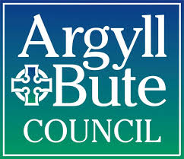
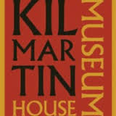



In development
Regional Archaeological Research Framework for Argyll (RARFA)
South East Scotland Archaeological Research Framework (SESARF)

Slide 15
Regional Archaeological Research Framework for Argyll (RARFA)
Coordinated by a museum
Cooperation from local authority archaeologist
“All developer-funded archaeological work will be required to contribute to or update the RARFA, if significant archaeological discoveries and/or research are made to the satisfaction of the planning authority, as advised by the West of Scotland Archaeology Service. West of Scotland Archaeology Service would agree the content of the contribution in advance. “
Unpublished DRAFT Regional Archaeological Research Framework for Argyll, page 7.

Slide 16
Regional Archaeological Research Framework for Argyll (RARFA)
Based on papers presented at a two day symposium in 2015
Period themed
Mixture of single and multi authored
Funded by HES through ScARF
Part time project coordinator
Current draft is around 85,000 words

Slide 17
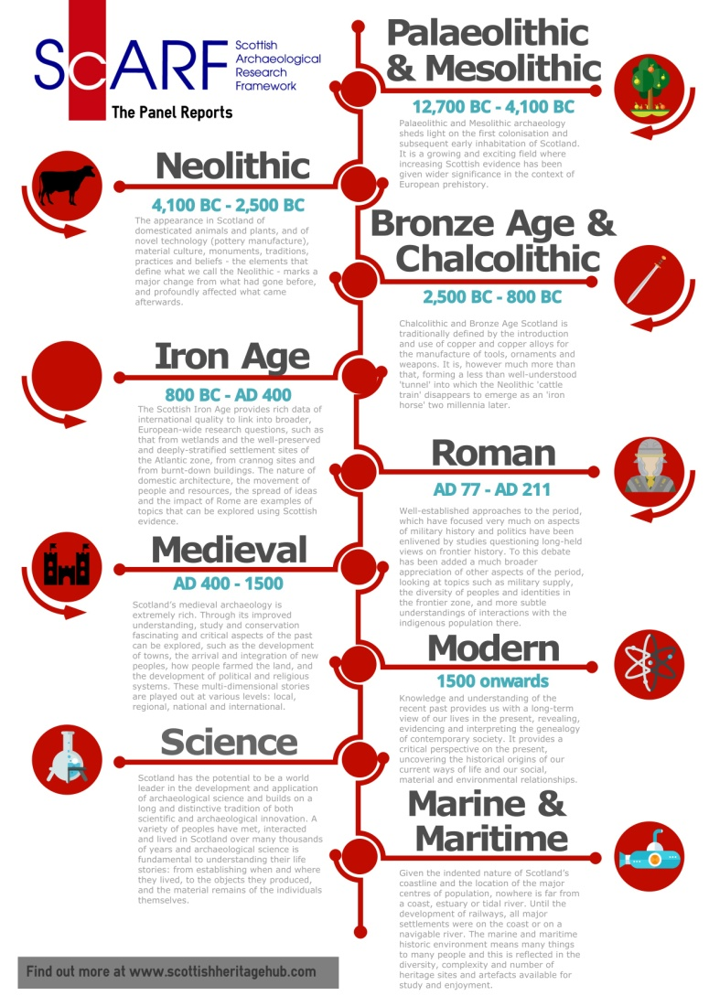
As a comparison
320+ people
800,000 words
1,100 hours per panel of writing and editing time
Notes:
Of particular interest to folk here might be these figures from 2012. I haven’t been keeping track of the figures since 2015 – not sure how I would!

Slide 18
What has ScARF done for RARFA?
General
Organised students to take notes at the symposium and subsequent meetings
Aided in adding experts to working groups to broaden the scope of expertise
Provided grant to cover travel expenses and accommodation for the speakers at the symposium and meetings
Creating a style guide for authors
Answered over 250 emails relating to the Argyll framework!
Online publication
HTML markup
Sorting copyright for some of the images
Publicity

Slide 19
South East Scotland Archaeological Research Framework (SESARF)
Coordinated by the archaeologists of three local councils
Project design by a commercial unit who tendered for the work
Not just archaeology:
historic environment
built heritage
historic landscapes
archives and collections
Funding application currently with HES as part of a Society funding bid
Notes:
If successful this could form a useful model for other regional research frameworks, taking account of regional conditions that impact upon archaeological research and providing greater efficiencies in the propagation of archaeological research. The value of SESARF is thus that it will create a shared baseline for understanding the resource and its archaeological research potential, both pure and applied. SESARF can also help define research goals for the historic environment sector and thus help identify opportunities for collaboration, partnerships, knowledge exchange and synergies between researchers within the sector and with those in other sectors.
The overall focus of SESARF will be archaeology, defined in broad terms as the historic environment and including built heritage and historic landscapes, archives and collections, intangible cultural heritage and bio-cultural heritage. It will address the research needs and opportunities for all of these aspects of the historic environment. Its chronological scope will span the Upper Palaeolithic to the 20th century.
SESARF will address our curiosity about the historic environment and the historical communities, processes, events and materials from which it derives. This is fed by academic knowledge, which is generated by ‘pure’ research.
A second goal is to address the interface between the historic environment and the physical environment of which it is part, including natural heritage, and its conservation and management needs. ‘Applied’ research which treats cultural heritage as part of its natural environment can address those needs and help to inform and improve understanding and management of the environment as a whole.
A third interface is at the intersection of the historic environment with people and communities in ways which can benefit them in the present, particularly in terms of health and wellbeing, socio-economic vitality, cultural enrichment and opportunities for education and employment. ‘Applied’ research into current and potential impacts of the historic environment can lead to the enhancement and improvement of these benefits.

Slide 20

What is a region?
Local authority area
Local council area
Planning authority
World heritage site
National park
Protected area

Slide 21
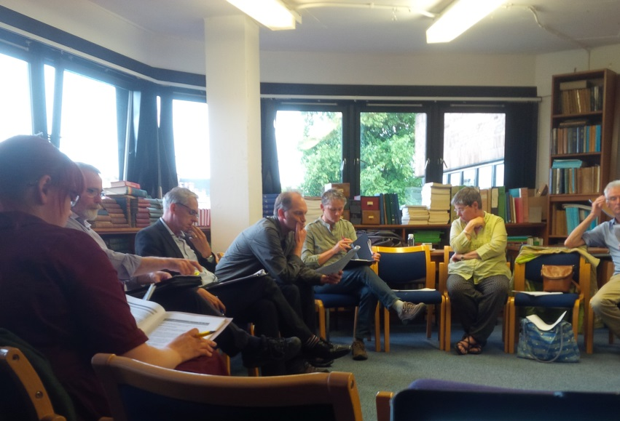
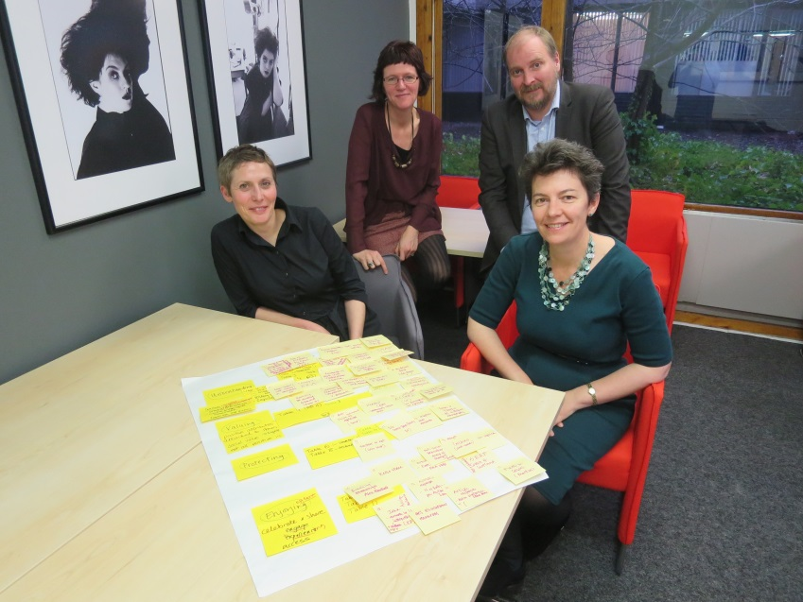
Lessons so far
Meetings
Number of, locations, travel time, accessibility, cost implications
Authors
Deciding on ‘experts’, ego clashes, differing opinions
Editing
Multi authored sections, extra unpaid work, other deadlines, comments, changes, style guides

Slide 22
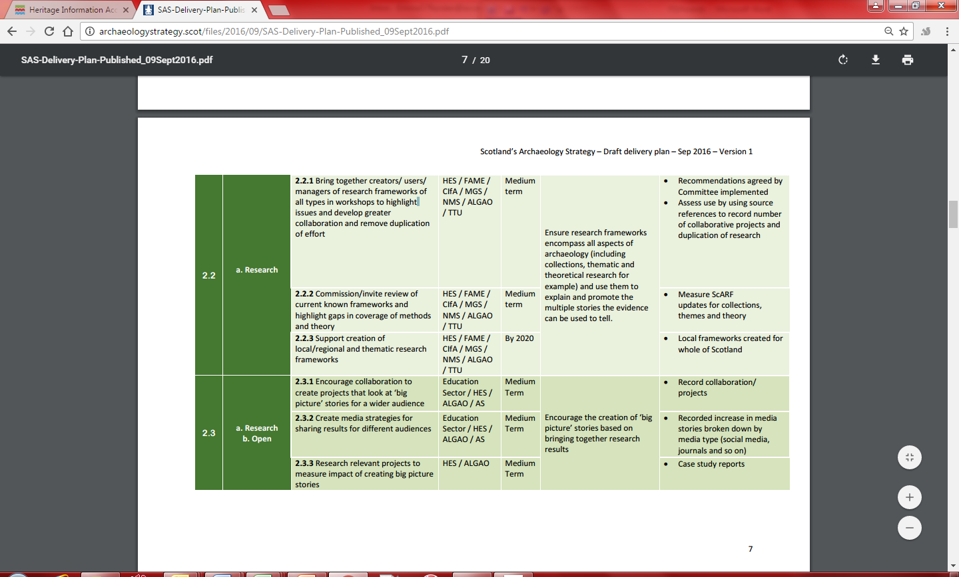
ScARF Regional Research – Timescale
2016
Current funding ends March 2018
RARFA meetings
2017
RARFA published online
Updated ScARF panel reports
New thematic ScARF reports?
Museums project continues until March 2019
SESARF initial symposium
SESARF workshops with consultees and stakeholders
SESARF funding application
Bid for funding to continue ScARF/SESARF until 2020

Slide 23
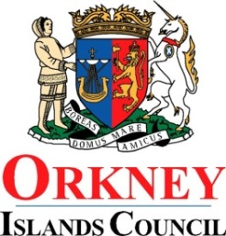
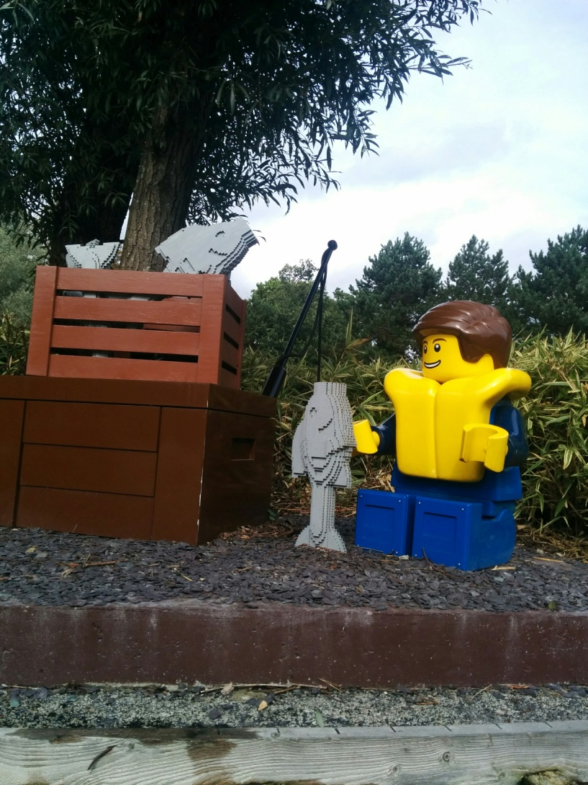
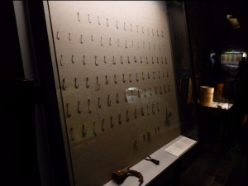

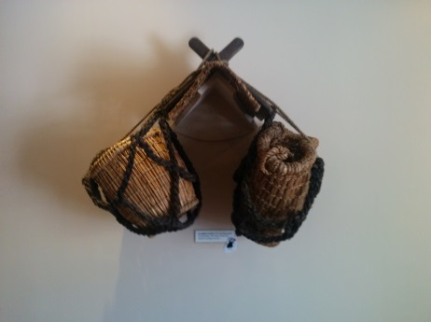
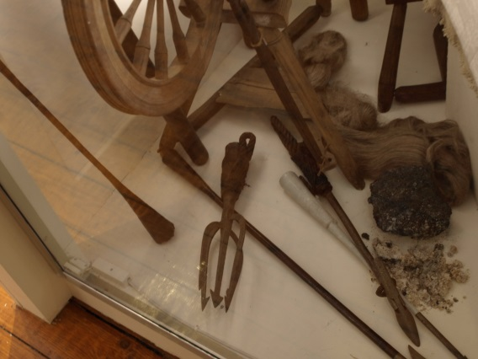
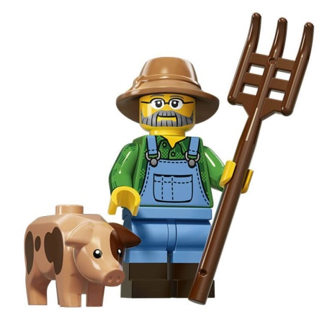
Museums Project
Overarching themes of ‘Farming’ and ‘Fishing’
highlight research gaps
encourage new research on existing collections
engage new audiences with Scottish archaeology
environment sector

Slide 24
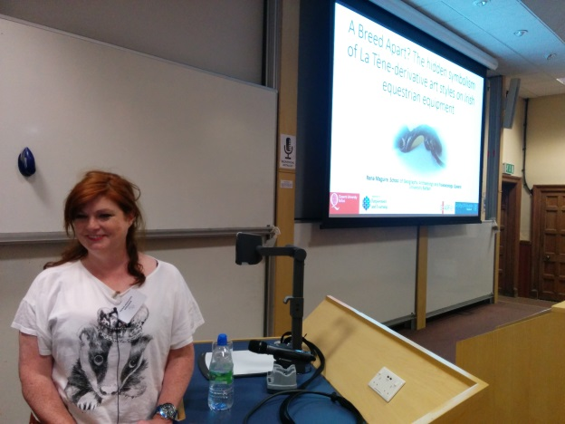
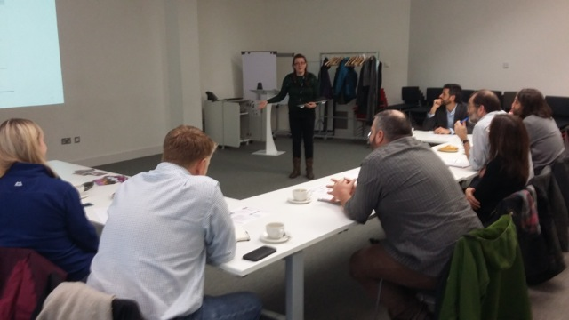
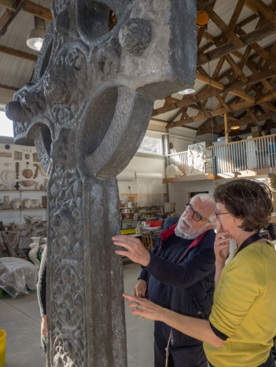
ScARF Project in summary
Now an integral part of the Archaeology Strategy
Develop a set of regional frameworks that cover all of Scotland
Refine the recommendations from 2012 to get nuanced answers to regional questions
Encourage contributions to regional and national frameworks from more commercial units, students, the third sector and object specialists
Provide training and skills workshops across the sector

Slide 25




Thank you
anna@socantscot.org
emma@socantscot.org
@ScARFhub
www.scottishheritagehub.com

